Slide 1






DROWSINESS DETECTION
TEAM ZEN :
EBISHDON G V
AISWARYA S M

Slide 2
TABLE OF CONTENTS
Introduction
Objectives
Existing System
Proposed System
Coding and Execution
Potential Impact
Conclusion
01
02
03
04
05
06
07

Slide 3

INTRODUCTION
Drowsy driving is a widespread and dangerous issue often underestimated in today's fast-paced world.
The Zebra's 2021 nationwide survey revealed that 17.2% of respondents admitted to falling asleep at the wheel at least once in their lives, indicating the common occurrence of drowsy driving incidents.
Alarmingly, 7.3% of survey participants felt safe as passengers of drowsy drivers, highlighting the need for heightened awareness and education.
Nearly 40% of respondents defined drowsy driving as "being unable to keep your eyes open" due to tiredness, revealing common misconceptions about this condition.
A majority (64.4%) of respondents believed that drowsy driving is just as dangerous as texting while driving, underlining the growing awareness of its risks.
Shockingly, almost one-third (31.3%) of participants considered drowsy driving to be less dangerous than drinking while driving, emphasizing the importance of changing public perceptions regarding the severity of this issue.

Slide 4






OBJECTIVES
SAFETY ENHANCEMENT
PRACTICAL IMPLEMENTATION
Emphasize the paramount importance of drowsiness detection in improving safety, preventing accidents, and saving lives in various domains, including transportation and critical work environments.
Provide insights into how drowsiness detection technology can be practically implemented in different contexts, enabling the audience to grasp its feasibility and potential for real-world use.

Slide 5

EXISTING SYSTEM
01
02
03
Critical Accuracy Issues:
Vital for safety, accuracy problems can lead to missed drowsiness signs or false alarms, posing a direct risk to lives on the road.
The system's inability to detect early signs of drowsiness could limit its preventive capabilities.
Variability due to individual and environmental factors impacts reliability, emphasizing the need for consistent performance.
Significant Complexity and Privacy Concerns:
The complexity of equipment maintenance and calibration is a barrier to widespread adoption, as it requires time and resources.
Privacy issues linked to the monitoring of driver behavior underscore the importance of respecting personal data and privacy regulations.
Strain on Budgets and Effectiveness Challenges:
High implementation and maintenance costs can be a financial burden for both vehicle manufacturers and consumers.
Inadequate warning time for drivers limits the system's potential to save lives.
Limited adaptability during long journeys raises concerns about its real-world effectiveness in preventing accidents.

Slide 6
PROPOSED SYSTEM
01
02
03
Real-Time Monitoring:
The system employs a camera and OpenCV technology for continuous monitoring of the driver's facial expressions and eye movement, ensuring real-time observation.
Advanced Machine Learning Analysis:
Cutting-edge machine learning algorithms like Haar Cascade Algorithm and MediaPipe to analyze the driver's behavior to detect drowsiness accurately and reliably.
Drowsiness Alert Triggered:
When signs of drowsiness are detected, the system initiates a series of proactive safety measures:
Automatic Speed Reduction: The car's speed is reduced to provide the drowsy driver with extra reaction time.
Audible Alert: An immediate audible alert notifies the driver about their drowsy state.
Hazard Lights Activation: Hazard lights are activated to alert neighboring drivers to the potential hazard.

Slide 7
PROPOSED SYSTEM
04
05
Real-Time Monitoring:
The system employs a camera and OpenCV technology for continuous monitoring of the driver's facial expressions and eye movement, ensuring real-time observation.
Versatile Integration and Privacy Compliance:
The system is designed for compatibility with a broad range of vehicle makes and models, making it accessible to a wide audience.
Data privacy is a priority, ensuring compliance with personal data protection regulations and guaranteeing driver information security.

Slide 8
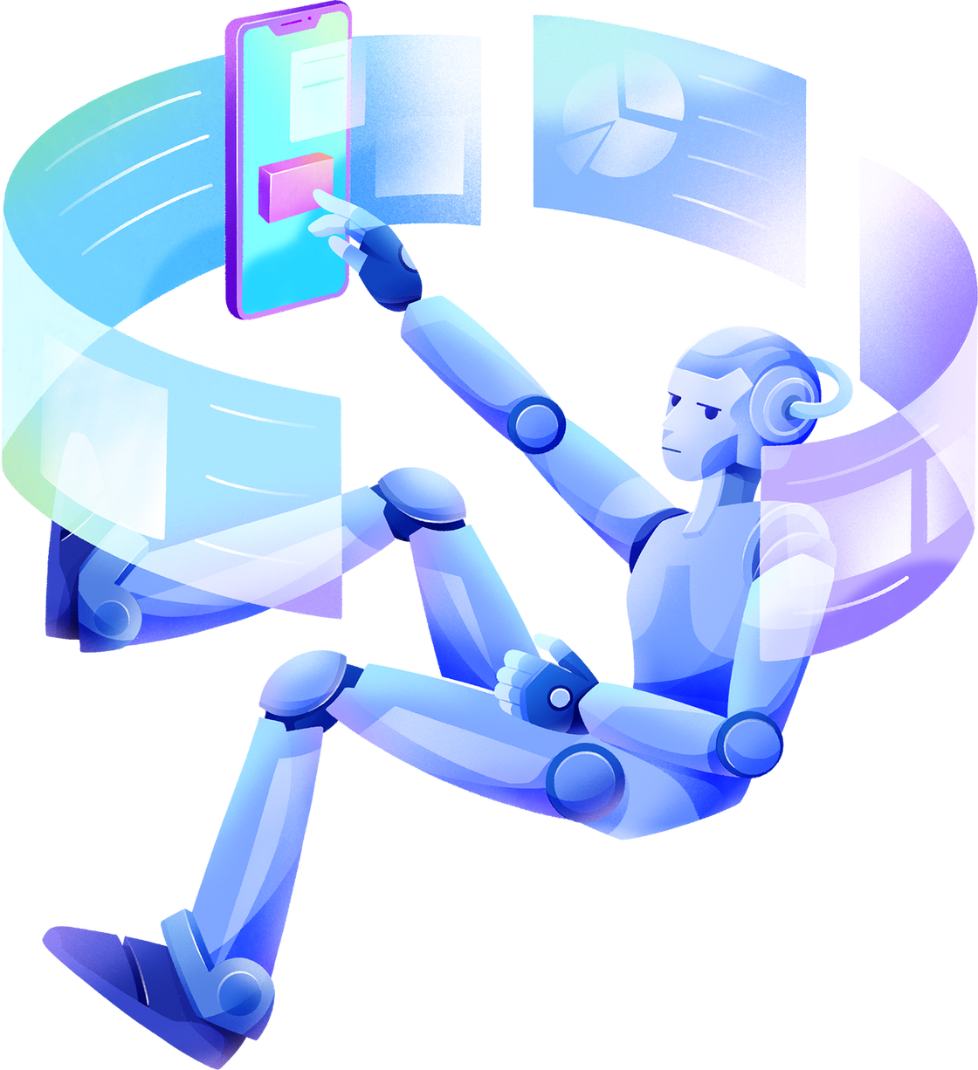

WHAT SOO UNIQUE!!
Proactive Safety: Uniquely initiates automatic speed reduction and hazard light activation when drowsiness is detected, offering immediate safety measures.
Advanced Technology: Integrates OpenCV and machine learning, providing precise early drowsiness detection, setting it apart in terms of accuracy.
Customization Focus: Offers extensive customization options for alerts, including sound preferences, catering to individual driver needs, a distinctive feature.
Wide Compatibility : Unique in its design to be compatible with a diverse range of vehicle makes and models, ensuring accessibility to a broad audience.
Holistic Approach: Takes a comprehensive approach to drowsiness detection and prevention, encompassing both awareness and immediate safety actions, a distinctive feature compared to single-alert systems.
Alerting the driver’s family : When the driver is not not waking up for more than 3 mins.

Slide 9


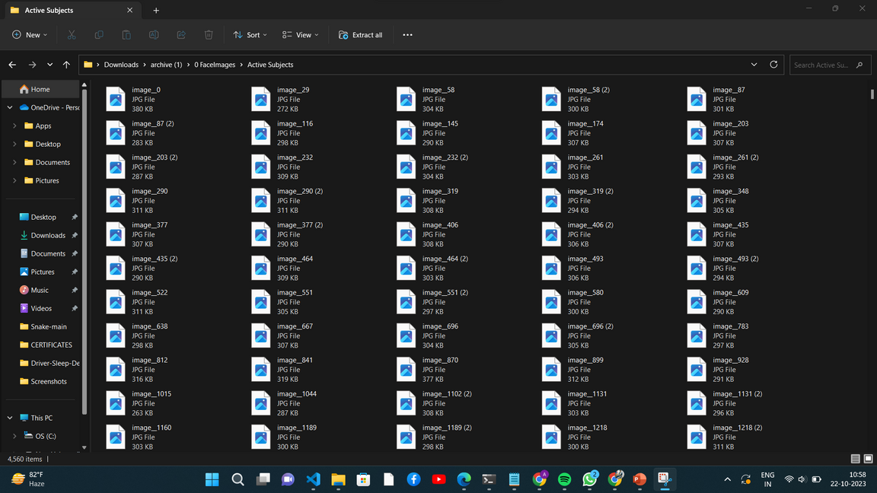
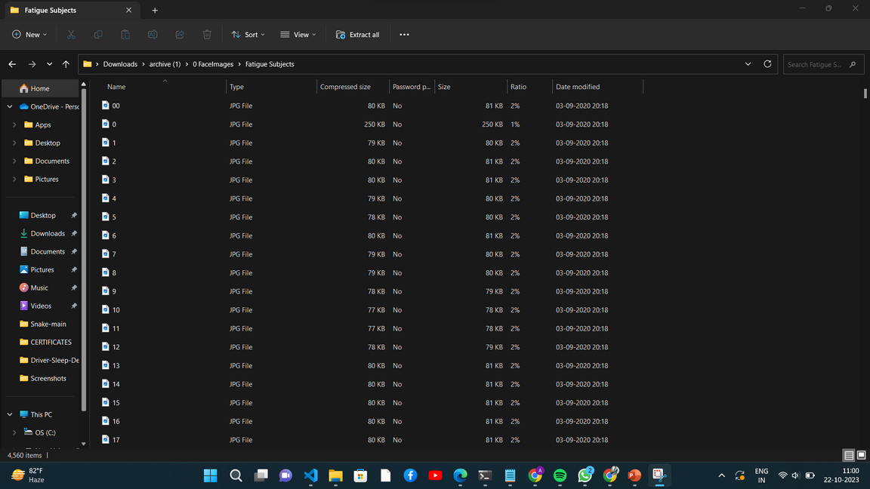

CODING AND EXECUTION

Slide 10
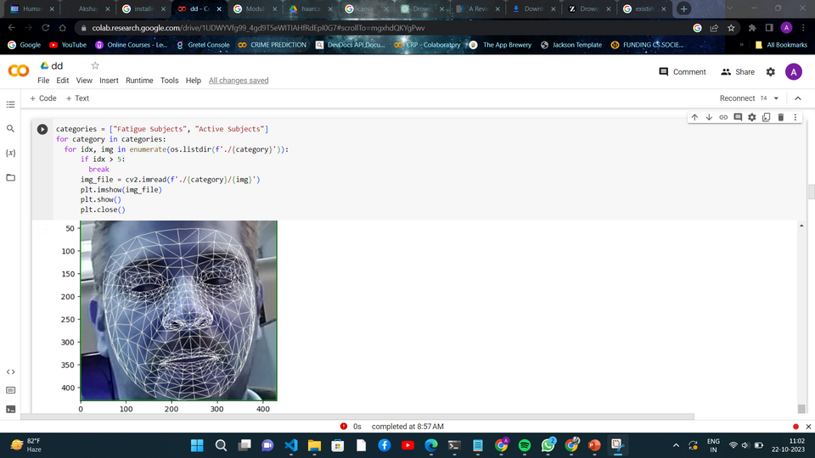
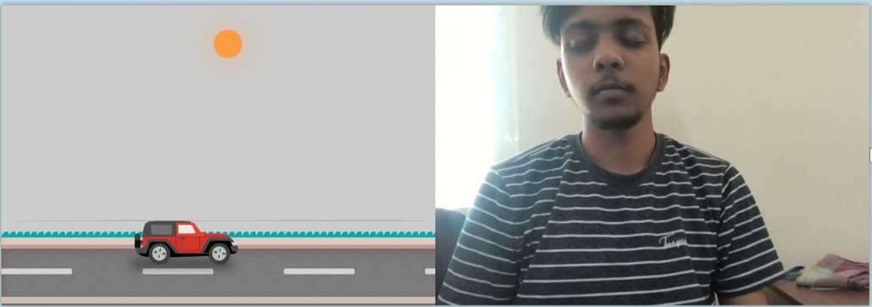
CODING AND EXECUTION

Slide 11
POTENTIAL IMPACT
•The adoption of ML/DL for drowsiness detection has the potential to revolutionize safety across various domains:
1. In transportation, it can prevent accidents caused by drowsy driving, saving lives and reducing injuries.
2. In the workplace, it can enhance the safety of employees operating heavy machinery or performing critical tasks.
3. In healthcare, it can ensure the alertness of healthcare professionals, preventing errors and ensuring patient safety.
•Beyond safety, this technology can improve overall well-being by reducing fatigue-related stress, enhancing productivity, and promoting healthier lifestyles.

Slide 12

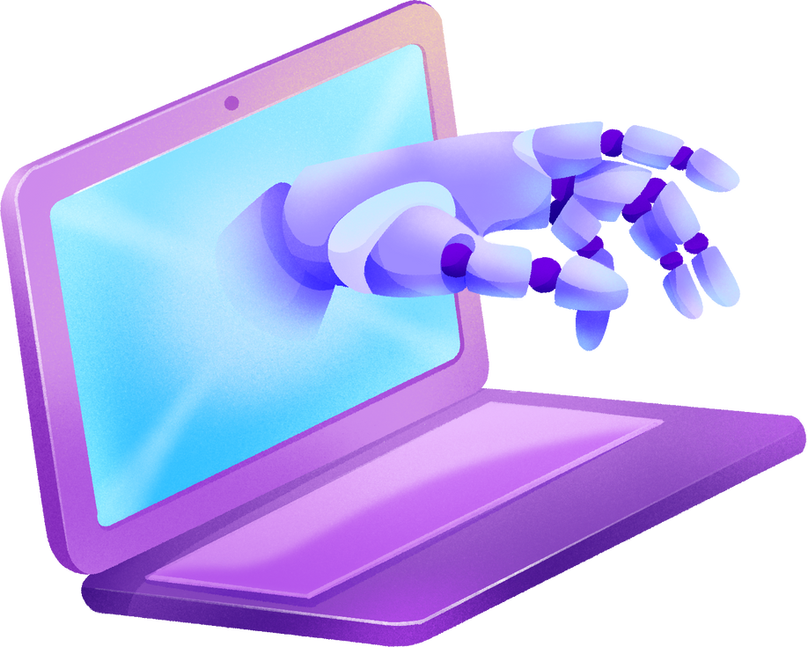
BUSSINESS CANVAS
KEY PARTNERS
REVENUE
Drivers
Electronic Companies
Vehicle Campanies
Product based Companies
Cost Structure
Primary Revnue from drivers on our device
Secondary Revenue include maintenance
and specialized vehicle modification and parts.
Camera and Sensors : Rs.10,000/-
Processing Data : Rs.10,0000/-
Dsiplay /Alert System : Rs.2,500/-
Software Development along with UI : Rs.3,00,000/- approx
Testing and Installation : Rs.1,00,000/- approx
TOTAL COST : Rs. 4,50,000/- approx

Slide 13

OUR IMPROVEMENT
PHASE 1 : DEVELOPED AN ML BASED BASIC DROWSINESS DETECTION SYSTEM WITH LSTM MODEL
PHASE II : DEVELOPMENT OF SOFTWARE SYSTEM BASED ON OPEN CV AND DL MODEL WITH AN ALERT SYSTEM TO THE DRIVER AND THE NEIGHBORING DRIVER
OUR FUTURE ENHANCEMENT
DEVELOPMENT OF HARDWARE WHICH IS TO BE INTEGRATED WITH THE AUTOMOBILES
TO IMPROVE ACCURACY FURTHER WE NEED TO UPGRADE A SYSTEM WHICH CAN DETECT BASED ON BIOLOGICAL BASED DETECTION

Slide 14
C O N C L U S I O N
Drowsiness detection using machine learning and deep learning technologies is of paramount importance, holding the potential to save lives and prevent accidents in various critical settings. While it offers significant promise, it also presents challenges, including data diversity, real-time processing, and ethical considerations, that must be addressed for responsible and effective implementation. Recognizing the vital role of drowsiness detection in enhancing safety and well-being, it is imperative that we continue to advance this technology while remaining vigilant about its limitations, striving for a future where it contributes to a safer and more secure society.

Slide 15

THANK YOU!

